Slide 1


Gyosmen-Hashims Shittu
September, 2022

Slide 2

Outline
Executive Summary
Introduction
Methodology
Results
Conclusion
Appendix

Slide 3
Executive Summary
Summary of methodologies
Data collection through API
Data collection with web scrapping
Data wrangling
Exploratory data analysis (EDA) with SQL
EDA with data visualization
Machine learning prediction
Summary of all results
EDA results
Interactive analytics
Predictive analytics

Slide 4
Introduction
Project background and context
SpaceX advertises that it's Falcon 9 rocket launches with a cost of 62 million dollars, a cost lower than other providers who put the cost upward of 165 million dollars. Much of the savings is because SpaceX can reuse the first stage. Therefore if we can determine if the first stage will land, we can then determine the cost of a launch. The goal of this project is to create a machine learning pipeline to predict if the first stage will land successfully.
Problems you want to find answers
What factors determine if the rocket will make a successful landing?
What are the interactions between these factors that determine the success of a landing?
What are the operating conditions that are required to be in place to ensure a successful landing?

Slide 5

Section 1

Slide 6
Methodology
Executive Summary
Data collection methodology:
Data was collected using the SpaceX API and web scraping
Perform data wrangling
One hot encoding was applied to categorical variables
Perform exploratory data analysis (EDA) using visualization and SQL
Perform interactive visual analytics using Folium and Plotly Dash
Perform predictive analysis using classification models
How to build, tune, evaluate classification models

Slide 7
Data Collection
Data used in this project were collected from the following sources:
SpaceX API to request SpaceX data
Web scraping to collect data for Falcon 9 launch records from a Wikipedia web page

Slide 8
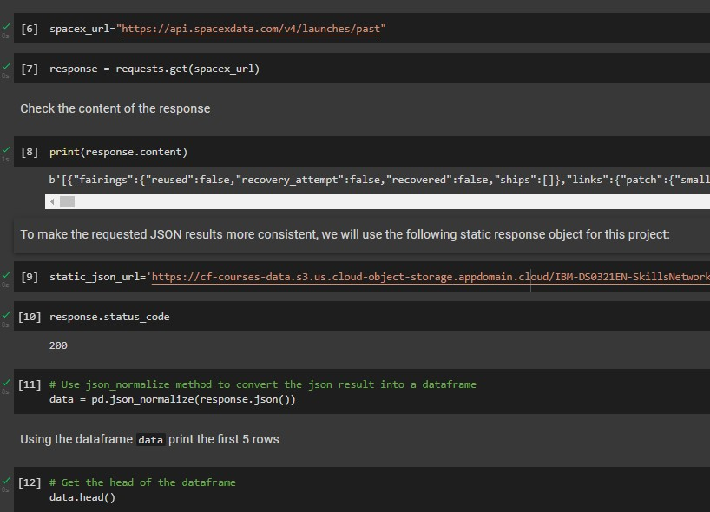
Data Collection – SpaceX API
We requested for data from the SpaceX API, cleaned the resulting data, performed data wrangling and formatting
The following link contains the notebook that shows this process: https://github.com/gmenshi4/IBM_Coursera_DS_repo/blob/main/Spacex_data_collection_api.ipynb

Slide 9
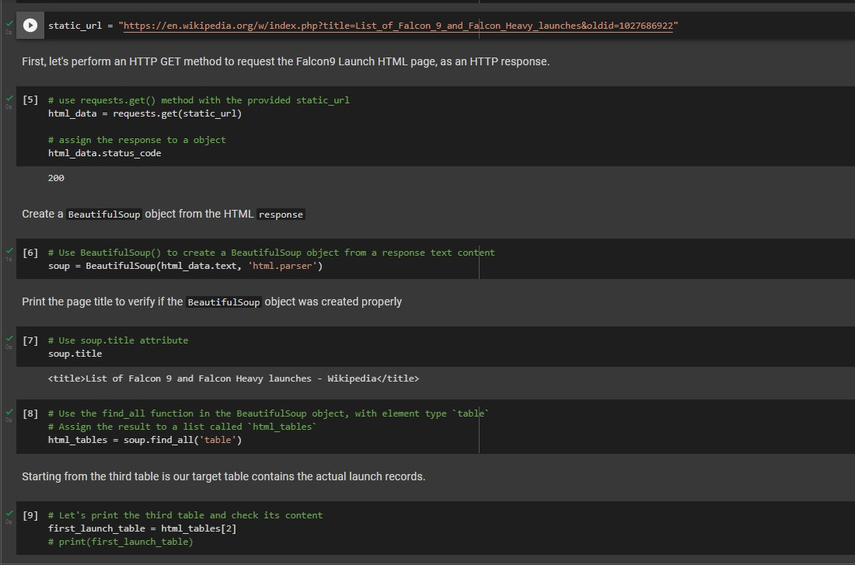
Data Collection - Scraping
Using webscaping, we were about to get data on Falcon 9 Launch records which we then converted into pandas dataframe
The following link contains the notebook that shows this process: https://github.com/gmenshi4/IBM_Coursera_DS_repo/blob/main/Data_collection_with_webscraping.ipynb

Slide 10
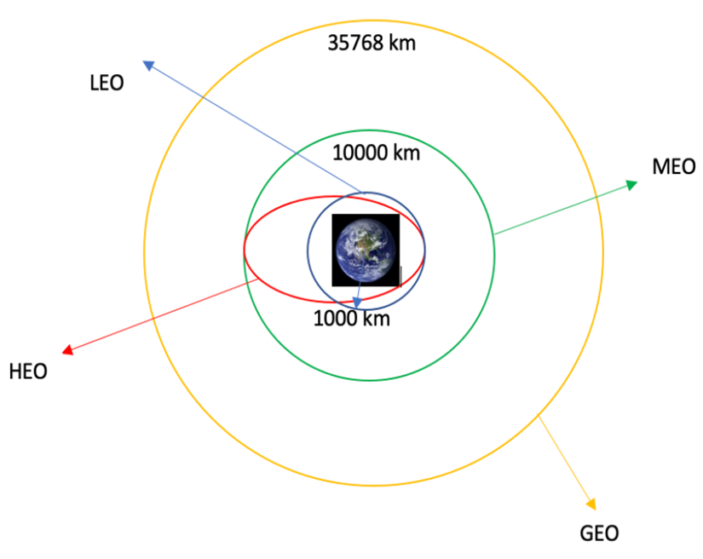
Data Wrangling
We determined the best training labels after exploratory data analysis
We then calculated the number of launches at each site and the number and occurrence of each orbit
The following link contains the notebook that shows this process: https://github.com/gmenshi4/IBM_Coursera_DS_repo/blob/main/Spacex_Data_wrangling.ipynb

Slide 11
EDA with Data Visualization
We explored the data by creating the following visualizations:
Scatter plots to determine if there is a relationship between the Launch Site and Payload, Launch Site and Flight Number, Orbit Type and Flight Number, Orbit Type and Payload and if these had any bearing on the success
Bar chat to get a better picture of the success rate by class of each orbit
Line plot to view the trend of the yearly success rate
The following link contains the notebook that shows this process: https://github.com/gmenshi4/IBM_Coursera_DS_repo/blob/main/EDA_Dataviz.ipynb

Slide 12
EDA with SQL
We connected to the SQL database and ran queries in order to help us gain more insight about the data. The queries helped us to get insight about the following:
The names of unique launch sites in the space mission.
The total payload mass carried by boosters launched by NASA (CRS)
The average payload mass carried by booster version F9 v1.1
The total number of successful and failure mission outcomes
The failed landing outcomes in drone ship, their booster version and launch site names.
The following link contains the notebook that shows this process:
https://github.com/gmenshi4/IBM_Coursera_DS_repo/blob/main/EDA_SQL_COURSERA_SQLLITE.ipynb

Slide 13
Build an Interactive Map with Folium
We marked all launch sites, and added map objects such as markers, circles, lines to mark the success or failure of launches for each site on the folium map.
We calculated the distances between a launch site to its proximities in order to answer questions such as:
Are launch sites near railways, highways and coastlines?
Do launch sites keep certain distance away from cities?
The following link contains the notebook that shows this process:
https://github.com/gmenshi4/IBM_Coursera_DS_repo/blob/main/Launch_site_location_with_folium.ipynb

Slide 14
Build a Dashboard with Plotly Dash
We built a Plotly Dash application for users to perform interactive visual analytics on SpaceX launch data in real-time.
We added a pie chat to show the total successful launches by all sites and also to show the successful launches by the different sites.
We also added a scatter plot to show the correlation between the payload and successful launches.
The following link contains the notebook that shows this process:
https://github.com/gmenshi4/IBM_Coursera_DS_repo/blob/main/spacex_dash_app.py

Slide 15
Predictive Analysis (Classification)
We created a column for class, standardized the data and split the data into testing (20%) and training (80%) sets.
We built Logistic Regression, Decision Tree, Support Vector Machine and K Nearest Neighbor machine learning models and tune different hyperparameters using GridSearchCV
We used accuracy as the metric for evaluation, improved the model using feature engineering and algorithm tuning.
We then found the best performing model and parameters.
The following link contains the notebook that shows this process:
https://github.com/gmenshi4/IBM_Coursera_DS_repo/blob/main/SpaceX_Machine_Learning_Prediction_Part_5.ipynb

Slide 16
Results
Exploratory data analysis results
Interactive analytics demo in screenshots
Predictive analysis results

Slide 17

Section 2

Slide 18
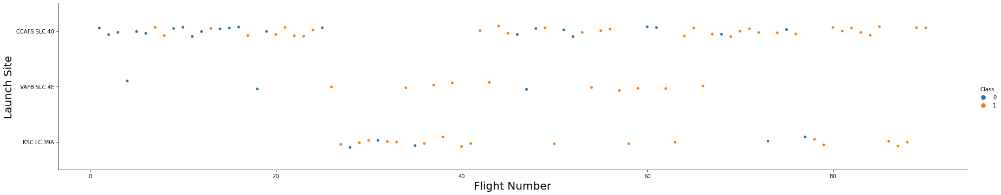
Flight Number vs. Launch Site
From the plot, we can see that the site CCAFS SLC 40 recorded more launches than any other launch site
We also see that there are more successes with the larger flight numbers as opposed to the smaller flight numbers

Slide 19
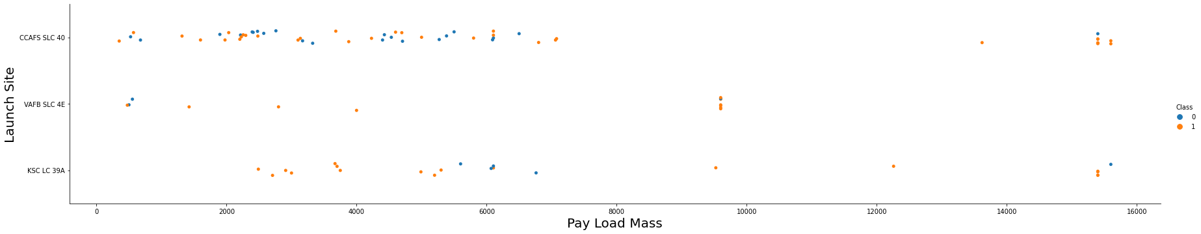
Payload vs. Launch Site
Here, that though the number of launches are fewer at higher payloads, we have more success at higher payload.
We can see however that with a payload mass of between 2000 and 4000, both VAFB SLC 4E and KSC LC 39A record great success as opposed to what we see from CCAFS SLC 40.

Slide 20
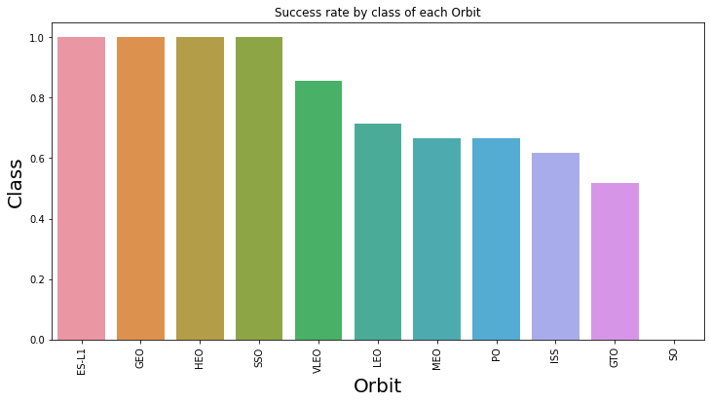
Success Rate vs. Orbit Type
From the plot, we can see that the orbits ES-L1, GEO, HEO, SSO and VLEO recorded the most success.

Slide 21
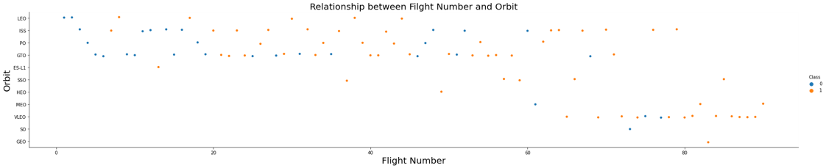
Flight Number vs. Orbit Type
We can see from the plot that all orbit types show relatively more success as the flight number increases

Slide 22
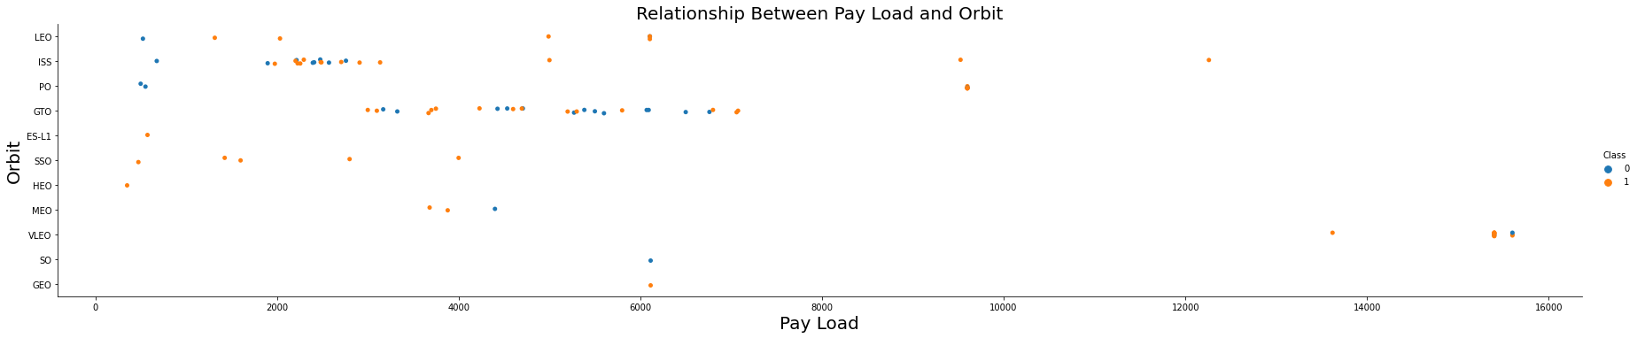
Payload vs. Orbit Type
We can observe here that with heavier payloads, there are more successes recorded for PO, LEO and ISS orbits while with lighter payloads ES-L1, SSO, HEO and MEO show greater success

Slide 23
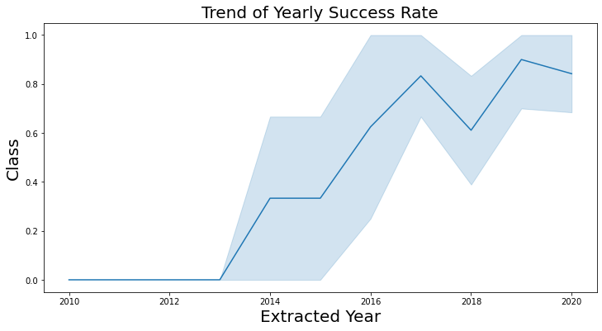
Launch Success Yearly Trend
From the plot, we can see that there was a progressive increase in success rate from 2013 to 2020 with a dip in 2018.

Slide 24
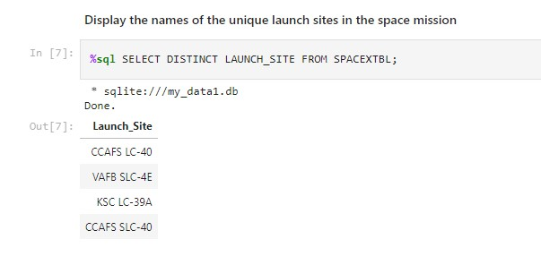
All Launch Site Names
From the query result, we can see there are only 4 Launch sites in the Space X data

Slide 25
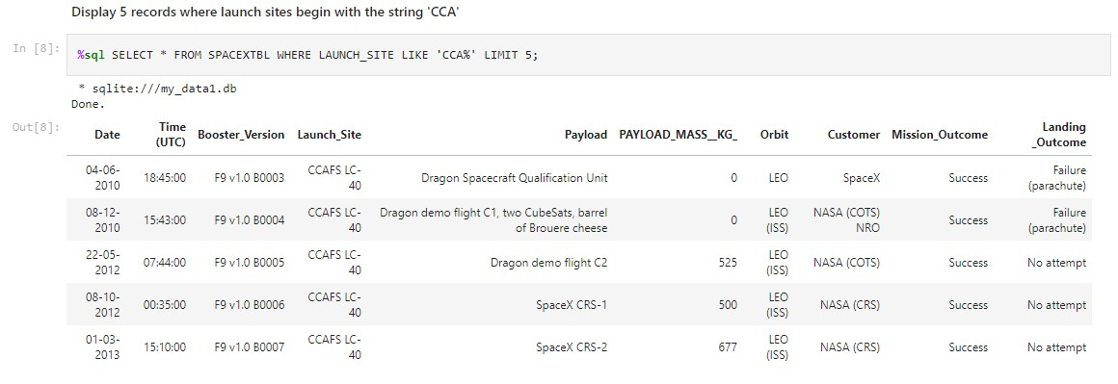
Launch Site Names Begin with 'CCA'
From the above query result, we can see that Mission Success was recorded in the Launch sites beginning with 'CCA'

Slide 26
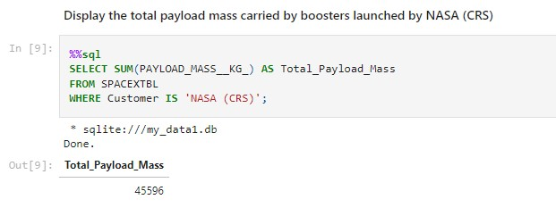
Total Payload Mass
The query result shows that the total payload mass recorded was 45,596kg

Slide 27
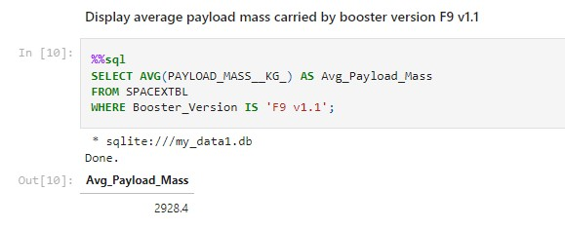
Average Payload Mass by F9 v1.1
The query result shows the average payload mass carried by booster version F9 v1.1 was 2,928.4kg

Slide 28
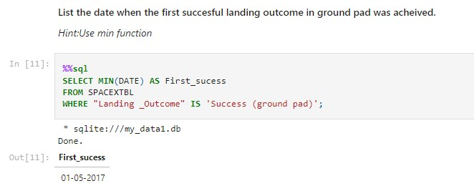
First Successful Ground Landing Date
The query result revealed that the first successful landing outcome on ground pad was recorded on the 1st of May, 2017

Slide 29
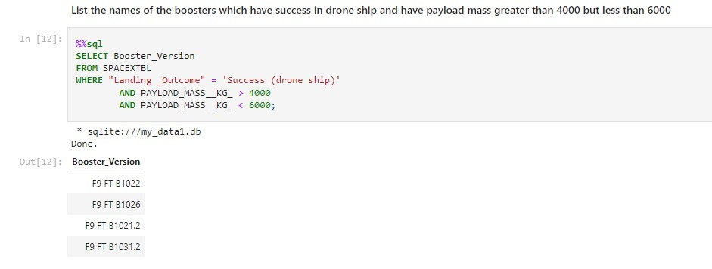
Successful Drone Ship Landing with Payload between 4000 and 6000
The query result shows that there are 4 booster versions with the successful drone ship landing having a payload between 4000 and 6000 as listed in the screen shot above.

Slide 30
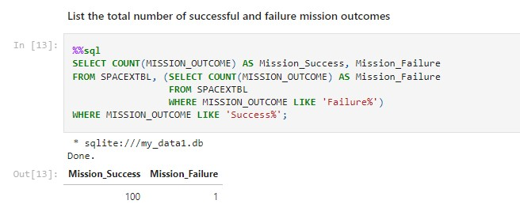
Total Number of Successful and Failure Mission Outcomes
From the query result above, we see that there were 100 mission successes with one recorded mission failure

Slide 31
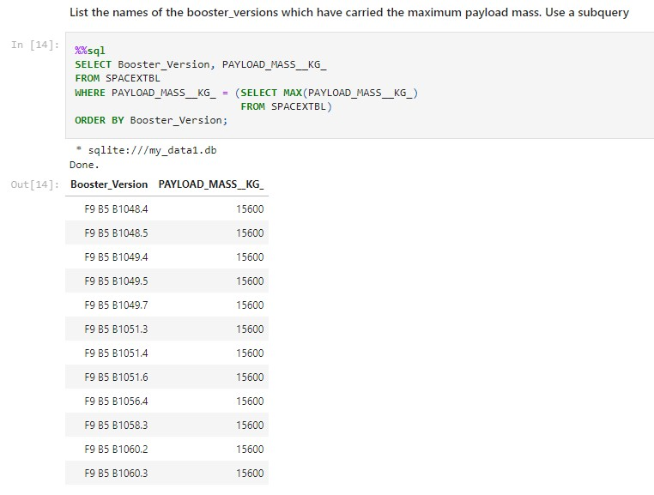
Boosters Carried Maximum Payload
The query result lists the boosters that have carried the maximum payload mass

Slide 32
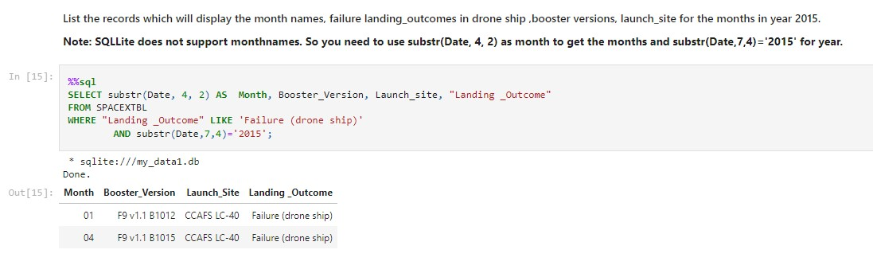
2015 Launch Records
The query shows the list of the failed landing outcomes in drone ships, their booster versions, launch site names and month of the failed mission for in year 2015

Slide 33
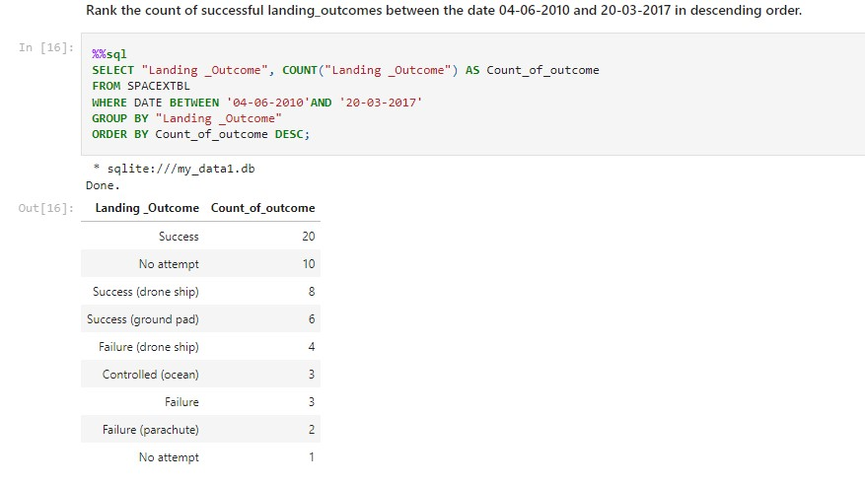
Rank Landing Outcomes Between 2010-06-04 and 2017-03-20
The query result above shows the ranked count of landing outcomes between the date 2010-06-04 and 2017-03-20 in descending order

Slide 34

Section 3

Slide 35
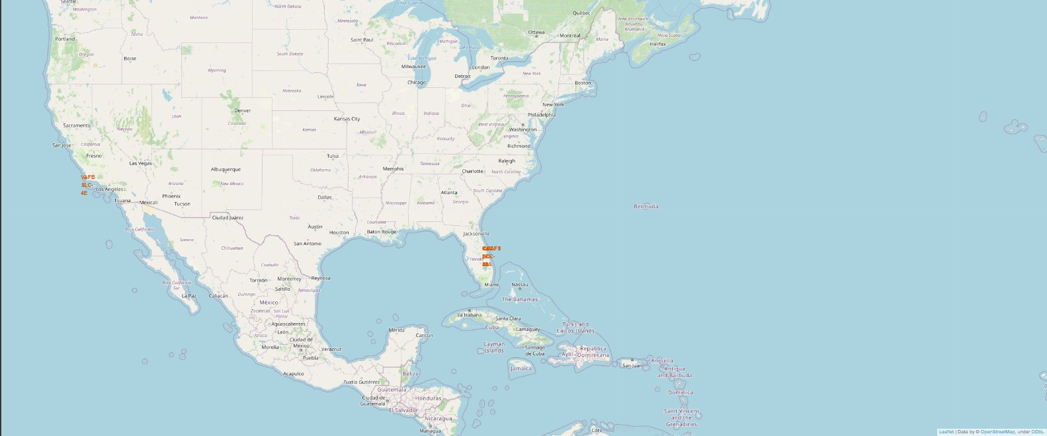
All launch sites global map markers
The map above shows that SpaceX launch sites are in the United States of America coastal states Florida and California

Slide 36
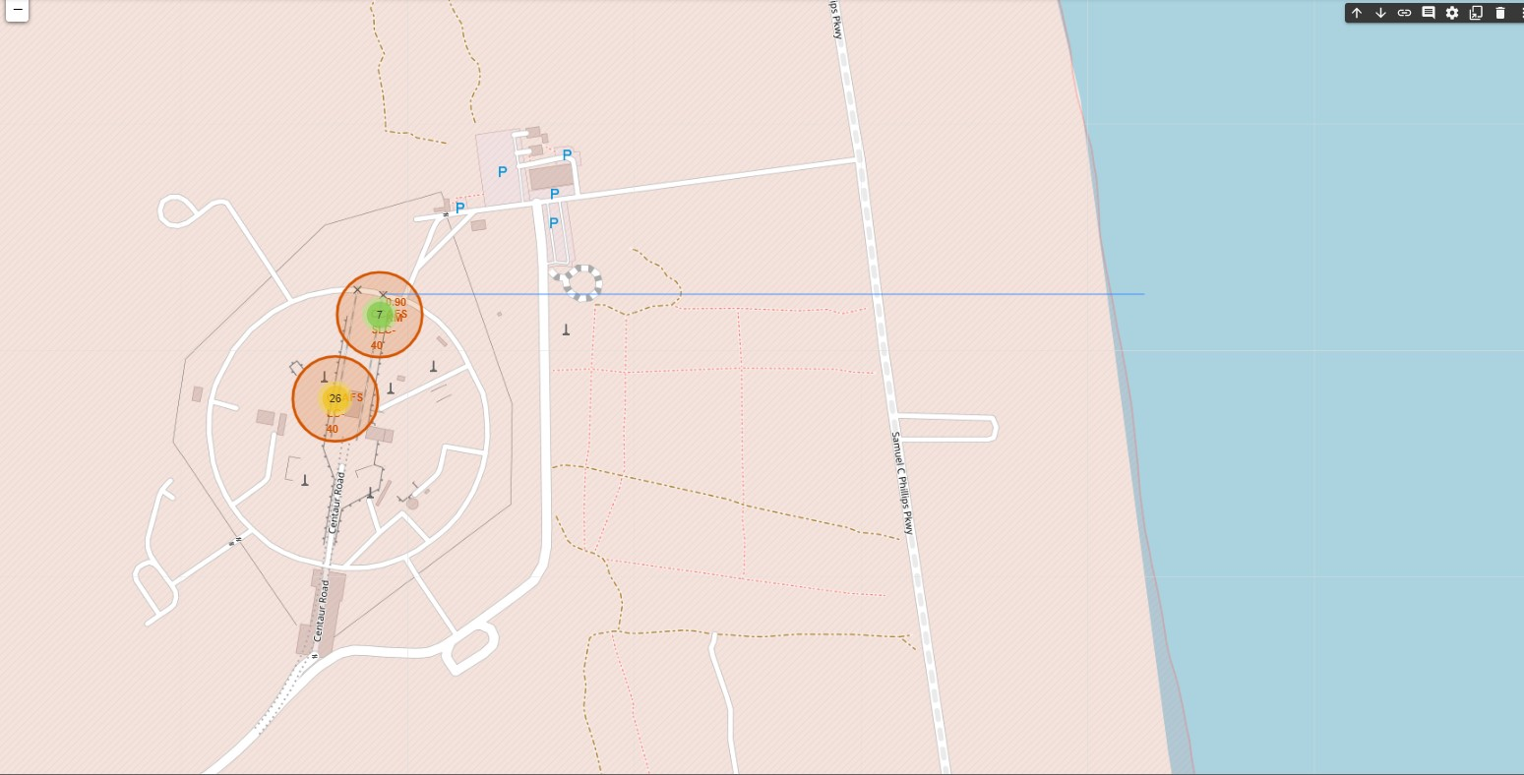
Closest Coastline to Launch Site in Florida
The map shows the closest coastline and the distance between the coastline point and the launch site in Florida.

Slide 37
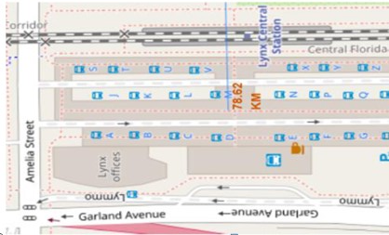
Closest Train Station to Launch Site
The map above shows the distance to the train station from the closest launch site

Slide 38

Section 4

Slide 39
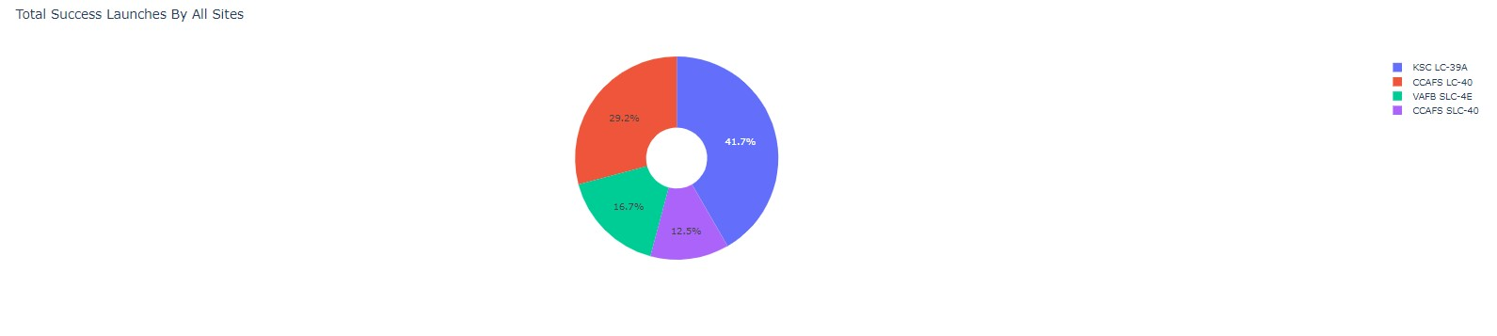
Launch Success count for all launch sites
Here we see that KSC LC-39A had the most successful launches of all sites

Slide 40
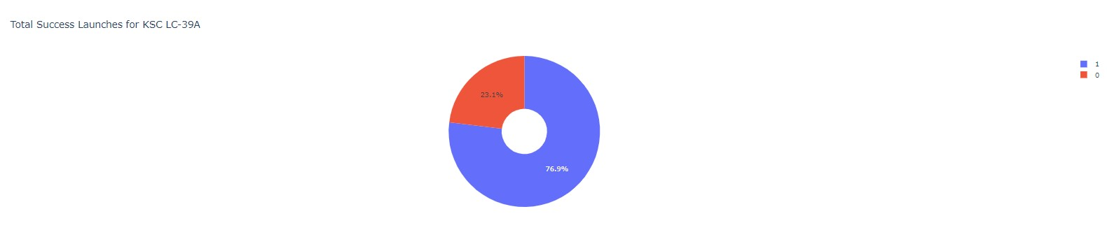
Launch site with highest launch success ratio
KSC LC-39A achieved an overall success of 76.9% with only 23.1% failures.

Slide 41
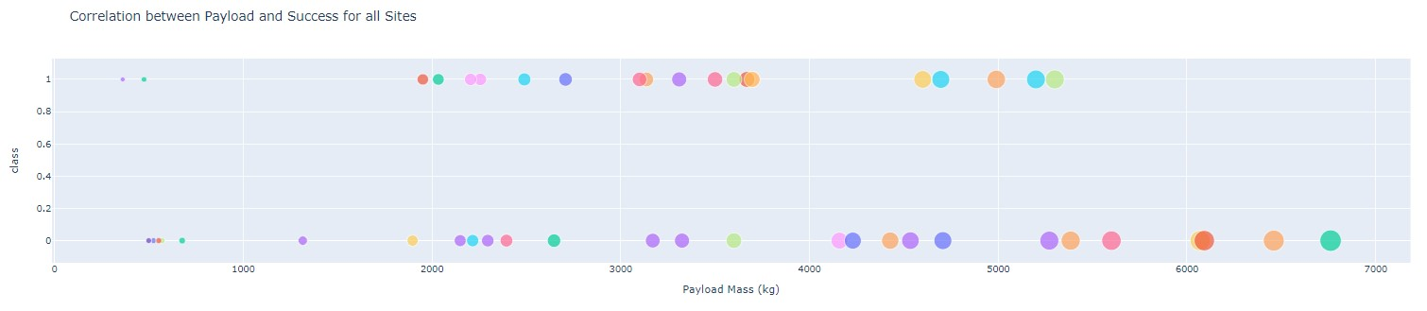
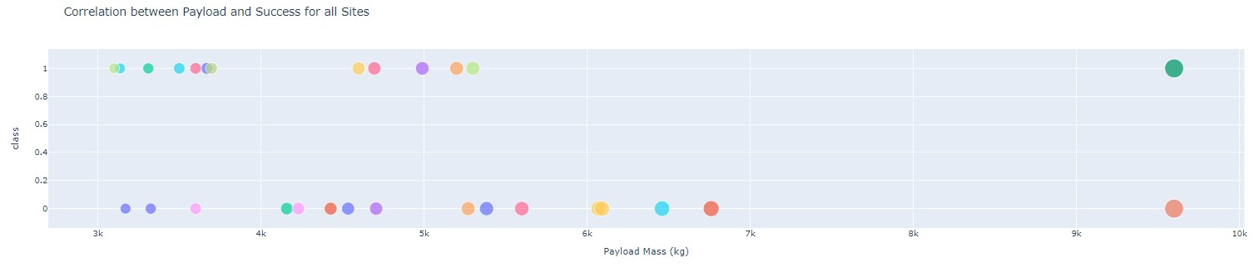
Payload vs Launch for all sites
We see that there are more success recorded for lower payloads than higher payloads

Slide 42

Section 5

Slide 43
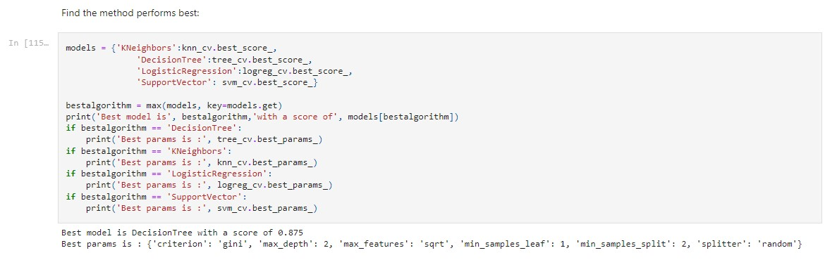
Classification Accuracy
Decision tree model has the highest classification accuracy

Slide 44
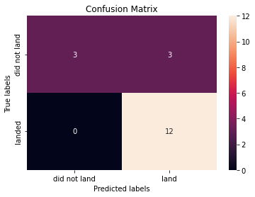
Confusion Matrix of Decision Tree
The confusion matrix shows that the model correctly distinguishes the successful landing but has a 50% prediction for the unsuccessful landings I.e the false positive.

Slide 45
Conclusions
From our analysis, we can make the following conclusions:
The large flight numbers result in more successes than the lower flight numbers at the launch sites
There was a steady increase in the yearly trend of the success rate in the years reviewed
The orbits ES-L1, GEO, HEO, and VLEO recorded the most successes.
KSC LC-39A is the site with the most successful launches of any sites
The Decision tree classifier is the best machine learning algorithm for this task.

Slide 46
Appendix
The data for the app created in this project can be found here:
https://github.com/gmenshi4/IBM_Coursera_DS_repo/blob/main/spacex_launch_dash.csv

Slide 47


